Slide 1
CSC 4780 – DNS and Security
Susmit Shannigrahi

Slide 2
DNS Overview
System on the Internet that maps names to numbers/IP addresses
A directory service
Google/ChatGPT but more definite
Think Telephone directory but numbers change very frequently
Almost everything depends on the Internet returning the right number for the right request
Break the DNS, break the Internet

Slide 3
History
Before DNS, all mappings were in hosts.txt
/etc/hosts on Linux
C:\Windows\System32\drivers\etc\hosts on Windows
Centralized, manual system
Changes were submitted to SRI via email
Machines periodically FTP new copies of hosts.txt
Administrators could pick names at their discretion
Any name was allowed
This_is_my_funny_name_on_the_web

Slide 4
History – Hosts.txt
Eventually, the hosts.txt system fell apart
Not scalable, SRI couldn’t handle the load
Hard to enforce uniqueness of names
e.g TTU
Tennessee Tech ot
Texas Tech
Many machines had inaccurate copies of hosts.txt
Thus, DNS was born

Slide 5
Naming Hierarchy
Root
net
edu
com
gov
mil
org
uk
fr
etc.
Top Level Domains (TLDs) are at the top
Maximum tree depth: 128
Each Domain Name is a subtree
.edu → tntech.edu → cs.tntech.edu → www.cs.tntech.edu
Name collisions are avoided
tntech
mit
cs
ece
husky
www
login
mail

Slide 6
Hierarchical Administration
Verisign
Root
ICANN
net
edu
com
gov
mil
org
uk
fr
etc.
Tree is divided into zones
Each zone has an administrator
Responsible for the part of the heirarchy
Example:
CCIS controls *.ccs.neu.edu
NEU controls *.neu.edu
tntech
mit
cs
www
login
mail

Slide 7
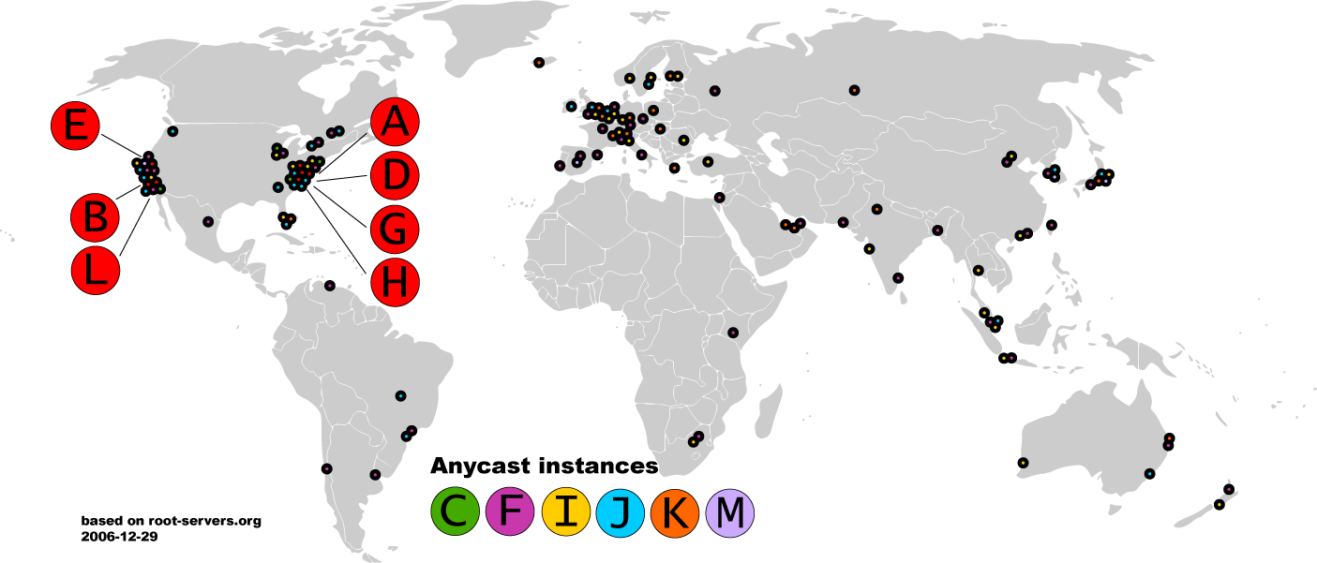
Map of the Roots - 2006

Slide 8
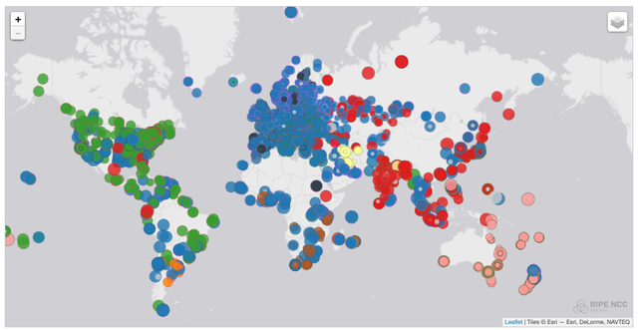
Map of the K Roots - 2017

Slide 9
DNS Resolving
When host makes DNS query, query is sent to its local DNS server.
acts as proxy, forwards query into hierarchy.
Two resolving schemes:
Iterative, and
Recursive.

Slide 10
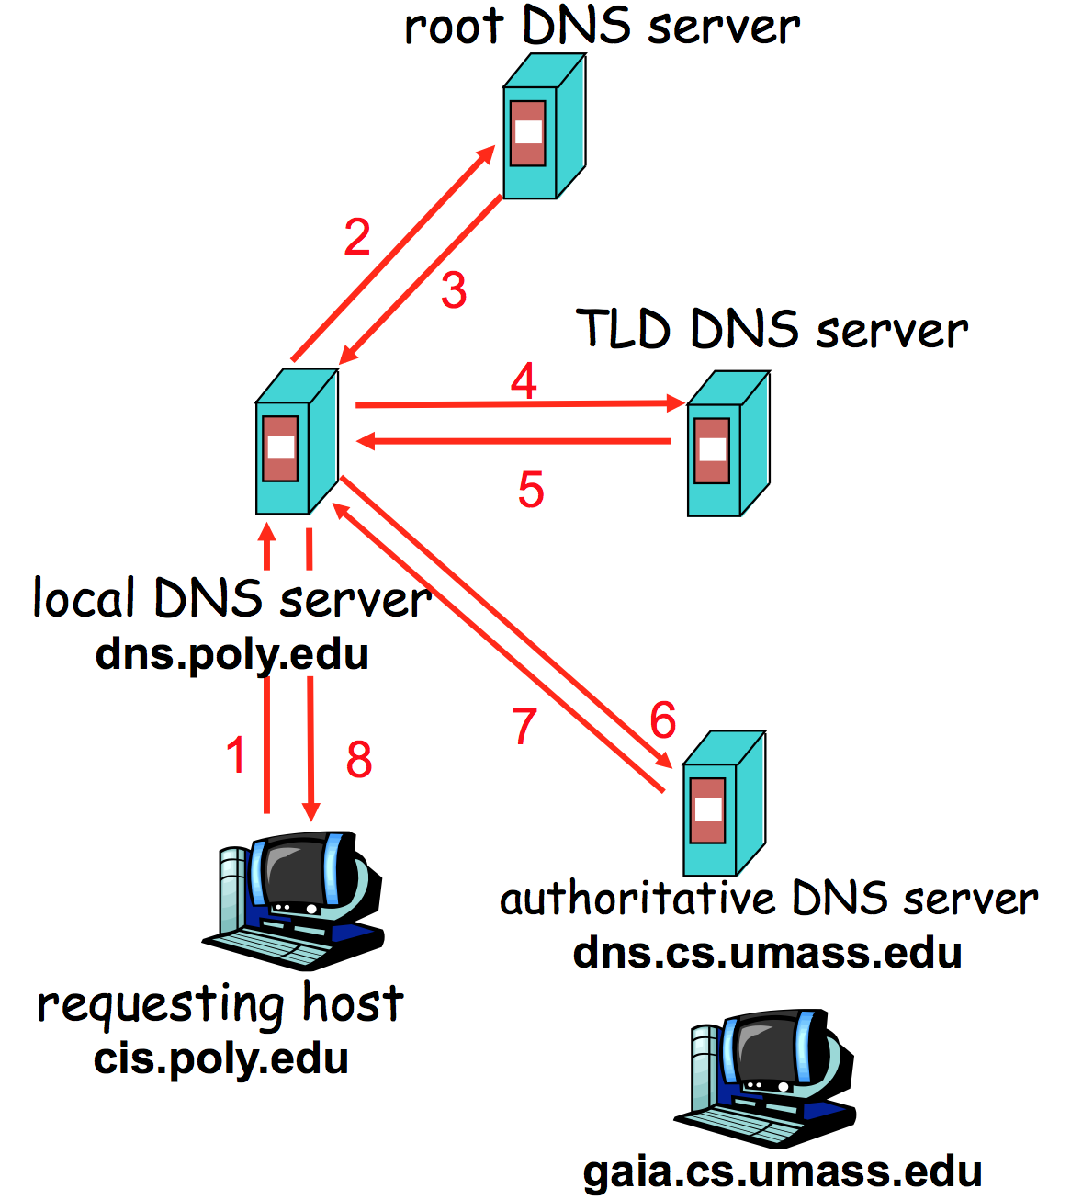
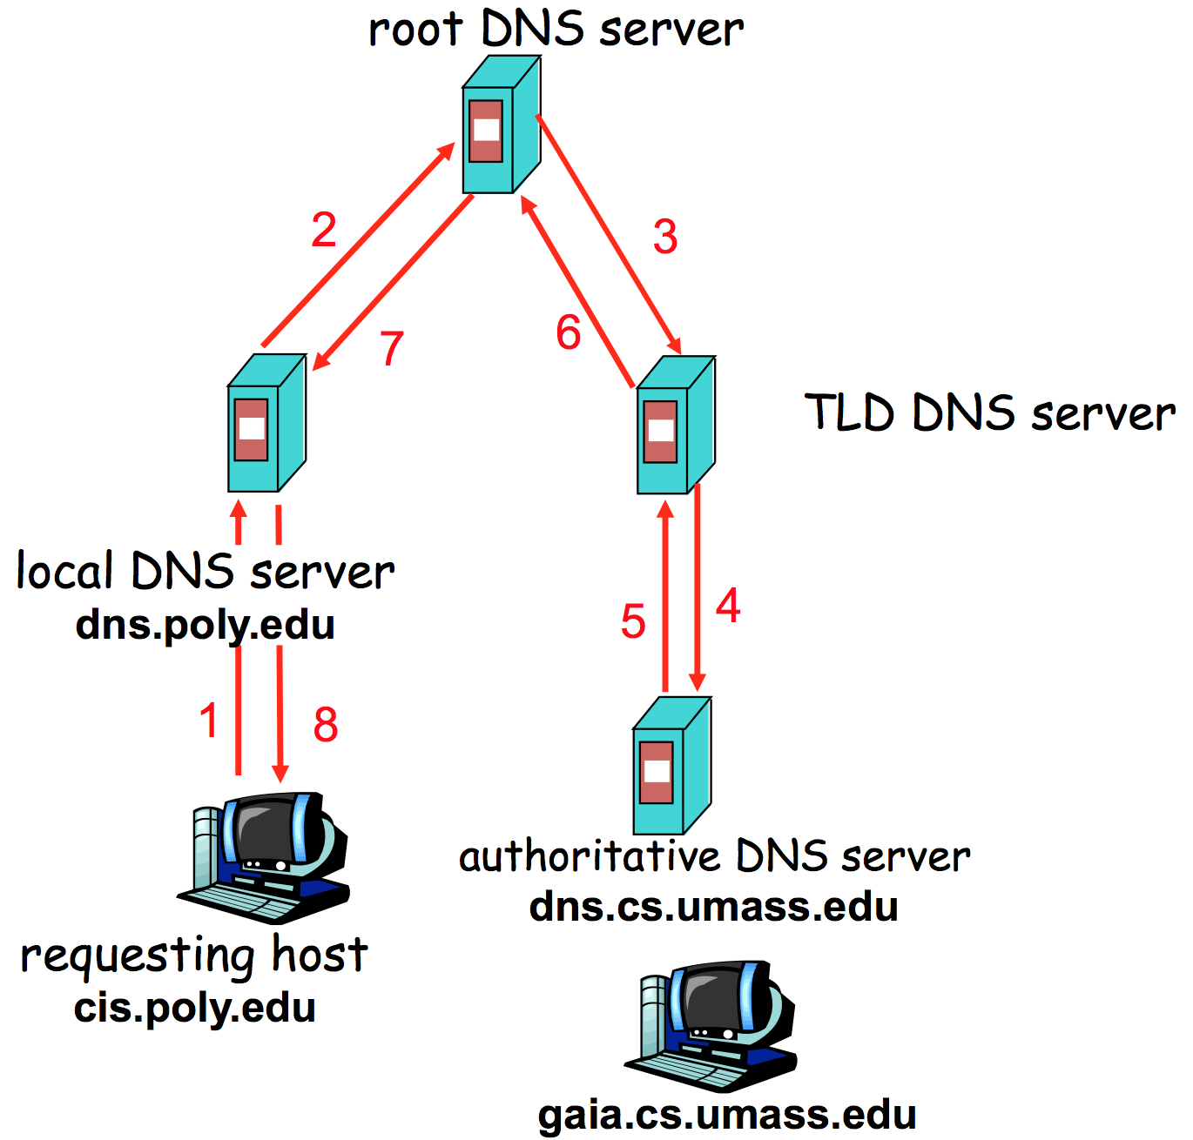
DNS Resolving - 2

Slide 11
DNS is Distributed
Three possible answers to any question
Here’s your number
Go away
I don’t know, ask that guy over there <- Delegate
Go ask the other guy a lot of work!
Infrastructure divided into Servers (that run around) and Clients, or Stub Resolvers, that either do or don’t get an answer
BIND = Name Server
Your Laptop = Stub Resolver

Slide 12
Caching
DNS responses are cached
Quick response for repeated translations
Negative results are also cached
Save time for nonexistent sites, e.g. misspelling
Cached data periodically times out
Each record has a TTL field

Slide 13
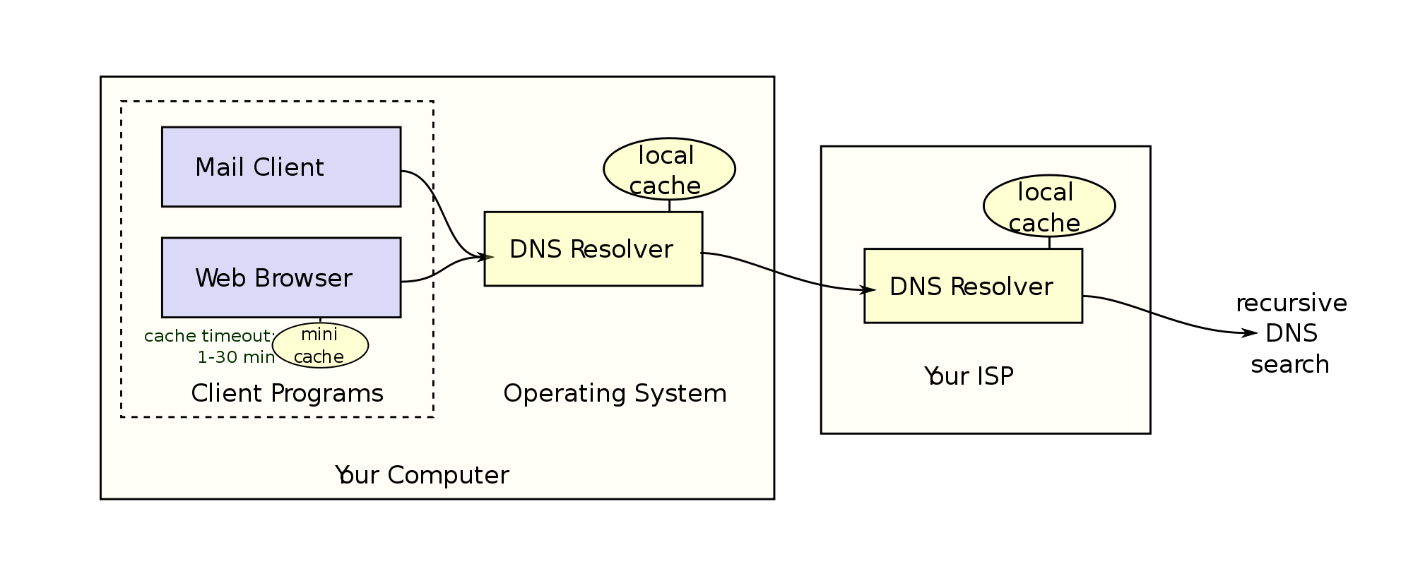
Caching - 2

Slide 14
Inherent DNS Vulnerabilities
Users/hosts typically trust the host-address mapping provided by DNS
What bad things can happen with wrong DNS info?
DNS resolvers trust responses received after sending out queries.
How to attack?
Obvious problem
No authentication for DNS responses
Notes:
Automatic software updates often relies on DNS.
Mail Servers.

Slide 15
Bad Guys and the guessing game
You are converting names to numbers. As a bad guy, don’t you want to return number quickly?
Yes!
What prevents this?
Transaction ID – 23654 (16 bit number)
Include this in your request
Bad actor doesn’t know this, so can’t reply with the correct number
But the bad server can guess
Transaction ID between 1-65K
When the good server wins, they set a TTL or Time to Live
This is how long that reply is valid
So Short or Long TTL?

Slide 16
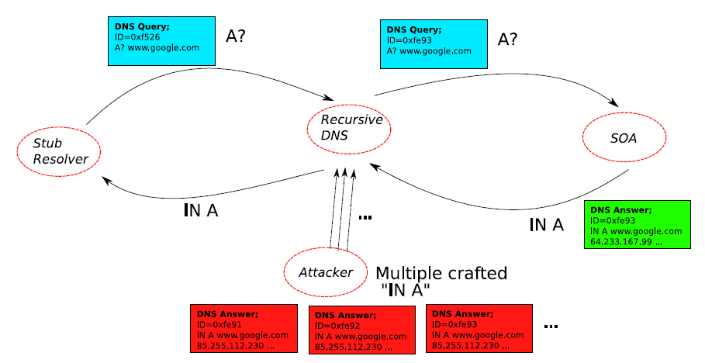
DNS cache poisoning: Racing to Respond First
Notes:
After the recursive DNS sends a query to SOA (Start Of Authority), the attacker responds first.

Slide 17
Long TTL – Maybe?
When it’s a race, the bad server has the advantage
Real requests take time to reply
Fake replies are faster – can be premade
Who says you can only reply once?
Bad servers can reply 100 times
Advantage goes from 65K to 1 to 655 to 1
So once you win, you keep winning
So if the good server wins, it makes sense to keep the TTL large
No?
Wait until slide 23

Slide 18
DNS Rake
Enter The DNSRake
Named after a common method for lockpicking
User is asking for foo.com
Local resolver sends a query to a nameserver, for $RANDOM.foo.com
The bad guy has the starter pistol
Send 200 fake replies to that nameserver, with TXID
The bad guy can reply multiple times
Send replies containing nameserver redirections to
www.foo.com IN A 6.6.6.6
If it fails, return to step 1, try again
Reply is cached until TTL

Slide 19
Defense Using The Bailiwicks Rules
The bailiwick system prevents foo.com from declaring anything about “com”, or some other new TLD, or www.google.com
Using the bailiwicks rules
The root servers can return any record
The com servers can return any record for com
The google.com servers can return any record for google.com

Slide 20
DNS cache poisoning – Birthday attack
Improve the chance of responding before the real nameserver (discovered by Vagner Sacramento in 2002)
Have many (say hundreds of) clients send the same DNS request to the name server
Each generates a query
Send hundreds of reply with random transaction IDs at the same time
Due to the Birthday Paradox, the success probability can be close to 1
300 will give you 50%.
700 will give you 1.07%

Slide 21
DNS cache poisoning – Kaminsky, 2008
Kaminsky Attack
Big security news in summer of 2008
DNS servers worldwide were quickly patched to defend against the attack
In previous attacks, when the attacker loses the race, the record is cached, with a TTL.
Before TTL expires, no attack can be carried out
Poisoning address for google.com in a DNS server is not easy.

Slide 22
What is New in the Kaminsky Attack?
The bad guy does not need to wait to try again
The bad guy asks the resolver to look up www.google.com
If the bad guy lost the race, the other race for www.google.com will be suppressed by the TTL
If the bad guy asks the resolver to look up 1.google.com, 2.google.com, 3.google.com, and so on
Each new query starts a new race
Eventually, the bad guy will win
he is able to spoof 183.google.com
So what? No one wants to visit 183.google.com

Slide 23
Kaminsky-Style Poisoning
A bad guy who wins the race for “183.google.com” can end up stealing “www.google.com” as well
Original malicious response:
google.com NS www.google.com
www.google.com A 6.6.6.6
Killer response:
google.com NS ns.badguy.com

Slide 24
Kaminsky-Style Poisoning (cont’)
Why it succeeded:
Can start anytime; no waiting for old good cached entries to expire
No “wait penalty” for racing failure
The attack is only bandwidth limited
Defense
Also randomize the UDP used to send the DNS query, the attacker has to guess that port correctly as well (increase the space of possible IDs).

Slide 25
So what do we do?
Difficulty to change the protocol
Protocol stability (embedded devices)
Backward compatibility.
Long-term
Cryptographic protections
E.g., DNSSEC, DNSCurve
Require changes to both recursive and authority servers
A multi-year process
Short-term
Only change the recursive server (local DNS).
Easy to adopt

Slide 26
Short-Term Defenses
Source port randomization
Add up to 16 bits of entropy
NAT could de-randomize the port
DNS 0x20 encoding
From Georgia tech, CCS 2008
Tighter logic for accepting responses

Slide 27
DNS-0x20 Bit Encoding
DNS labels are case insensitive
Matching and resolution is entirely case insensitive
A resolver can query in any case pattern
E.g., WwW.ExAmpLe.cOM
It will get the answer for www.example.com

Slide 28
DNS-0x20 DNS Encoding (cont’)
The mixed pattern of upper and lower case letters constitutes a channel, which can be used to improve DNS security
Only the real server knows the correct pattern
A DNS response contains the query being asked
When generating the response, the query is copied from the request exactly into the response
The case pattern of the query is preserved in the response
Open source implementations exhibit this behavior
The DNS request is rewritten in place

Slide 29
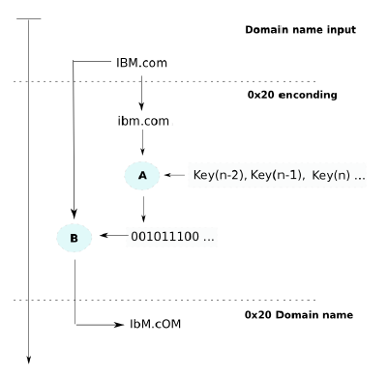
Query Encoding
Transforms the query into all lowercase
Encrypt the query with a key shared by all queries on the recursive server (A)
The cipher text is used to encode the query
0: buff[i] |= 0x20 (upper)
1: buff[i] &= 0x20 (lower)
Notes:
A 0x41 while a is 0x61

Slide 30
DNS-0x20 Encoding Analysis
Do existing authority servers preserve the case pattern?
Yes

Slide 31
Other DNS attacks
Attacking home routers/gateways
Incidence in Mexico in 2008
an email sent to users
email include URL (HTTP requests) to the HTTP-based interface of wireless routers
using the default password to reconfigure the router/gateway

Slide 32
Long Term Solution
DNSSEC:
Authenticate responses.
Google DNS now is enabled by default.
Challenges in deployment:
Response is large, might no linger fit in single UDP message.
Legacy software and machines.
Not without problems and controversy

Slide 33
Takeaway
Security problems can be really nuanced
More security isn’t better - deep understanding and logical thinking is.
Availability is more important than security

Slide 34
Reading List
It’s the end of the cache as we know it
https://blackhat.com/presentations/bh-jp-08/bh-jp-08-Kaminsky/BlackHat-Japan-08-Kaminsky-DNS08-BlackOps.pdf
An Illustrated Guide to the Kaminsky DNS Vulnerability
http://unixwiz.net/techtips/iguide-kaminsky-dns-vuln.html

Slide 35
CSC4780
DNSSEC Slides adapted from Olag Kampman and Bill Manning and Jeff Houston

Slide 36
DNSSEC Mechanisms
New Resource Records
Setting Up a Secure Zone
Delegating Signing Authority

Slide 37

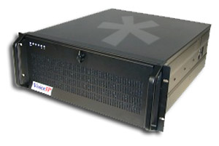

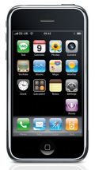
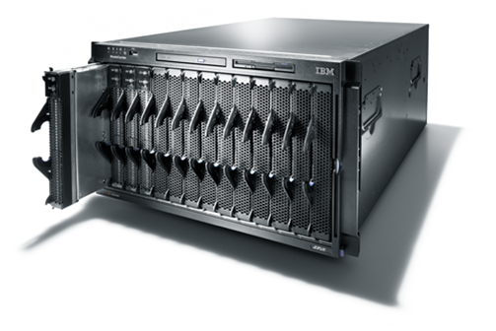
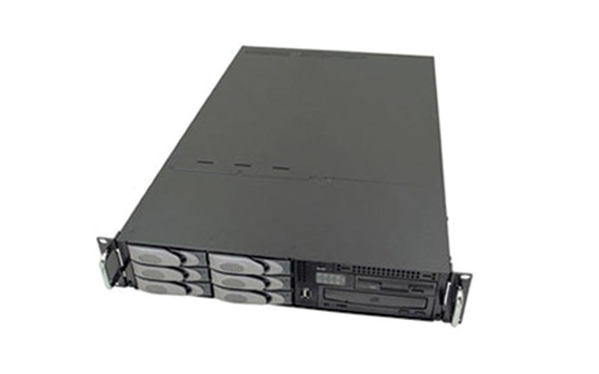
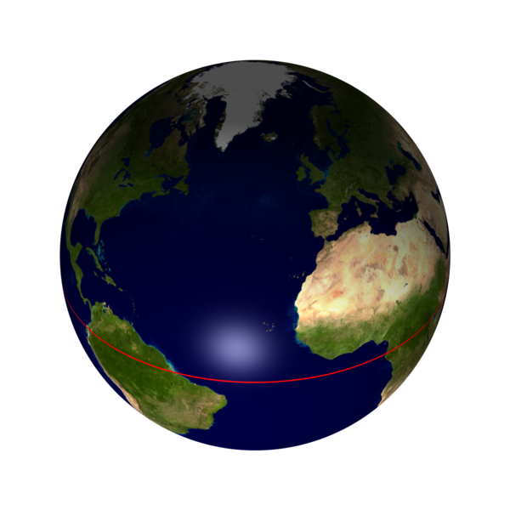
Data flow through the DNS
Where are the vulnerable points?
Registrars
& Registrants
Server vulnerability
Secondary
DNS
Man in the Middle
primary
DNS
spoofing
&
Man in the Middle
Registry
Secondary
DNS

Slide 38
DNSSEC protects all these end-to-end
As an aside: There is a protection mechanism against the man in the middle: TSIG (transaction signature, see RFC 2845)
Provides one hop security
TSIG is operationally deployed today
Based on shared secret: not scalable

Slide 39
What does DNSSEC provide
provides message authentication and integrity verification through cryptographic signatures
You know who provided the signature
No modifications between signing and validation
It does not provide authorization
It does not provide confidentiality
It does not provide protection against DDOS

Slide 40
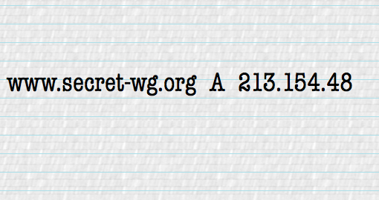
Apply Sig
Data flow through the DNS
End to end security
Registrars
& Registrants
OK
OK
Secondary
DNS
Validate Sig
primary
DNS
Registry
Secondary
DNS

Slide 41
Trust and Confidence
DNS system
Registry system
DNSSEC enables confidence in the DNS
It does not change the trust we put in the Registry/Registrar procedures
Although introduction of DNSSEC may improve some of the procedures
Root and TLD still need good practices

Slide 42
Mechanisms used
1 | RSA/MD5 |  | Must Not Implement
3 | DSA/SHA-1 |  | Optional
5 | RSA/SHA-1 | RFC 3110 | Required
7 | RSASHA1-NSEC3-SHA1 | RFC 5155 | Recommended
8 | RSA/SHA-256 | RFC 5702 | Recommended
10 | RSA/SHA-512 |  | Recommended
12 | GOST R 34.10-2001 | RFC 5933 | Optional
13 | ECDSA/SHA-256 | RFC 6605 | Recommended
14 | ECDSA/SHA-384 |  | Recommended

Slide 43
Three new components
Private Key: kept private and stored locally
Public Keys: Published in the DNS as a DNSKEY Resource Record
Signatures: Published in the DNS as a RRSIG Resource Record

Slide 44
Signing is done per Zone
Each zone has one or more key-pairs for signing
If you have the public keys from a zone you can validate signatures made with the corresponding private keys
However, signing a complete zone does not scale

Slide 45
RRs and RRSets
Resource Record:
name TTL class type rdata
www.nlnetlabs.nl. 7200 IN A 192.168.10.3
RRset: RRs with same name, class and type:
www.nlnetlabs.nl. 7200 IN A 192.168.10.3
A 10.0.0.3
A 172.25.215.2
RRsets are the atomic data units in the DNS
RRsets are signed, not the individual RRs

Slide 46
DNSKEY RDATA
16 bits: FLAGS
8 bits: protocol
8 bits: algorithm
N*32 bits: public key
nlnetlabs.nl. 3600 IN DNSKEY 256 3 5 (
AQOvhvXXU61Pr8sCwELcqqq1g4JJ
CALG4C9EtraBKVd+vGIF/unwigfLOA
O3nHp/cgGrG6gJYe8OWKYNgq3kDChN)
Notes:
1 1 1 1 1 1 1 1 1 1 2 2 2 2 2 2 2 2 2 2 3 3
0 1 2 3 4 5 6 7 8 9 0 1 2 3 4 5 6 7 8 9 0 1 2 3 4 5 6 7 8 9 0 1
+-+-+-+-+-+-+-+-+-+-+-+-+-+-+-+-+-+-+-+-+-+-+-+-+-+-+-+-+-+-+-+-+
| flags | protocol | algorithm |
+-+-+-+-+-+-+-+-+-+-+-+-+-+-+-+-+-+-+-+-+-+-+-+-+-+-+-+-+-+-+-+-+
| /
/ public key /
/ /
+-+-+-+-+-+-+-+-+-+-+-+-+-+-+-+-+-+-+-+-+-+-+-+-+-+-+-+-+-+-+-+-|
Flags:
                                             
   

   
When dealing with ZONE data NAMTYPE is set to 01.
If bit 0 and 1 are both 0 then the key can be used for authentication and confidentiality. DNSSEC normally sets these two bits to 0.
If bit 0 and 1 are set, then there is NO key and the RR stops after the algorithm octet.
Flags 0XC100 = 49408
Protocol: For DNSSEC the protocol is 3. IPSEC would have 4 in the protocol field.
Algorithm: 1 RSA/MD5 [RFC 2537]
2 Diffie-Hellman [RFC 2539] - optional, key only
3 DSA [RFC 2536] – Mandatory in implementations
4 reserved for elliptic curve crypto
5 RSA/SHA1 [RFC3110] – Mandatory in implementations
There are developments to restrict the use of KEYs to DNSSEC only. So only allow protocol 3 and drop some of the flags see: draft-ietf-dnsext--restrict-key-for-dnssec-??.txt

Slide 47
RRSIG RDATA
16 bits - type covered
8 bits - algorithm
8 bits - nr. labels covered (used for wildcard queries)
32 bits - original TTL
nlnetlabs.nl. 3600 IN RRSIG A 5 2 3600 (
20050611144523 20050511144523 3112 nlnetlabs.nl.
VJ+8ijXvbrTLeoAiEk/qMrdudRnYZM1VlqhN
vhYuAcYKe2X/jqYfMfjfSUrmhPo+0/GOZjW
66DJubZPmNSYXw== )
32 bit - signature expiration
32 bit - signature inception
16 bit - key tag
signer’s name
Notes:
1 1 1 1 1 1 1 1 1 1 2 2 2 2 2 2 2 2 2 2 3 3
0 1 2 3 4 5 6 7 8 9 0 1 2 3 4 5 6 7 8 9 0 1 2 3 4 5 6 7 8 9 0 1
+-+-+-+-+-+-+-+-+-+-+-+-+-+-+-+-+-+-+-+-+-+-+-+-+-+-+-+-+-+-+-+-+
| type covered | algorithm | labels |
+-+-+-+-+-+-+-+-+-+-+-+-+-+-+-+-+-+-+-+-+-+-+-+-+-+-+-+-+-+-+-+-+
| original TTL |
+-+-+-+-+-+-+-+-+-+-+-+-+-+-+-+-+-+-+-+-+-+-+-+-+-+-+-+-+-+-+-+-+
| signature expiration |
+-+-+-+-+-+-+-+-+-+-+-+-+-+-+-+-+-+-+-+-+-+-+-+-+-+-+-+-+-+-+-+-+
| signature inception |
+-+-+-+-+-+-+-+-+-+-+-+-+-+-+-+-+-+-+-+-+-+-+-+-+-+-+-+-+-+-+-+-+
| key tag | |
+-+-+-+-+-+-+-+-+-+-+-+-+-+-+-+-+ signer's name +
| /
+-+-+-+-+-+-+-+-+-+-+-+-+-+-+-+-+-+-+-+-+-+-+-+-+-+-+-+-+-+-+-+-/
/ /
/ signature /
/ /
+-+-+-+-+-+-+-+-+-+-+-+-+-+-+-+-+-+-+-+-+-+-+-+-+-+-+-+-+-+-+-+-+
In the example above the algorithm is type 1 (RSA), the key tag is 3122 and the signer’s name is bla.foo; Kbla.foo+001+3122 is the key used to sign. The A record that has the same label as this SIG.
The labels covered field is to help the resolver tell that the answer is a result of wildcard substitution.

Slide 48
Validate Public Keys
Make sure you get them from the appropriate entity and configure them as trust-anchors
If you validate against the wrong public key there is a problem again
For DNSSEC: key distribution through the DNS
Ideally only one key needed: that of the root of the DNS hierarchy (more on that later)

Slide 49
Delegating Signing Authority
Chains of Trust

Slide 50
Locally Secured Zones
Delegate Signing Security
.
NS and DS
NS & DS
com.
net.
money.net.
os.net.
kids.net.
corp
Secure entry points
dop
mac
unix
nt
marnick
dev
market
dilbert

Slide 51
Using the DNS to Distribute Keys
Secured islands make key distribution problematic
Distributing keys through DNS:
Use one trusted key to establish authenticity of other keys
Building chains of trust from the root down
Parents need to sign the keys of their children
Only the root key needed in ideal world
Parents always delegate security to child

Slide 52
Delegation Signer (DS)
Delegation Signer (DS) RR indicates that:
delegated zone is digitally signed
indicated key is used for the delegated zone
Parent is authorative for the DS of the child’s zone
Not for the NS record delegating the child’s zone!
DS should not be in the child’s zone

Slide 53
DS RDATA
16 bits: key tag
8 bits: algorithm
8 bits: digest type
20 bytes: SHA-1 Digest
$ORIGIN nlnetlabs.nl.
lab.nlnetlabs.nl. 3600 IN NS ns.lab.nlnetlabs.nl
lab.nlnetlabs.nl. 3600 IN DS 3112 5 1 ( 239af98b923c023371b52
1g23b92da12f42162b1a9 )
Notes:
draft-ietf-dnsext-delegation-signer-xx.txt
1 1 1 1 1 1 1 1 1 1 2 2 2 2 2 2 2 2 2 2 3 3
0 1 2 3 4 5 6 7 8 9 0 1 2 3 4 5 6 7 8 9 0 1 2 3 4 5 6 7 8 9 0 1
+-+-+-+-+-+-+-+-+-+-+-+-+-+-+-+-+-+-+-+-+-+-+-+-+-+-+-+-+-+-+-+-+
| type covered | algorithm | digest type |
+-+-+-+-+-+-+-+-+-+-+-+-+-+-+-+-+-+-+-+-+-+-+-+-+-+-+-+-+-+-+-+-+
| SHA-1 digest |
+-+-+-+-+-+-+-+-+-+-+-+-+-+-+-+-+-+-+-+-+-+-+-+-+-+-+-+-+-+-+-+-+
| 20 bytes |
+-+-+-+-+-+-+-+-+-+-+-+-+-+-+-+-+-+-+-+-+-+-+-+-+-+-+-+-+-+-+-+-+
| |
+-+-+-+-+-+-+-+-+-+-+-+-+-+-+-+-+-+-+-+-+-+-+-+-+-+-+-+-+-+-+-+-+
| |
+-+-+-+-+-+-+-+-+-+-+-+-+-+-+-+-+-+-+-+-+-+-+-+-+-+-+-+-+-+-+-+-+
| |
+-+-+-+-+-+-+-+-+-+-+-+-+-+-+-+-+-+-+-+-+-+-+-+-+-+-+-+-+-+-+-+-+
Note that the same 20 bytes hash is also used in the creation of a RSA SHA1 signature. The crypto strength of the pointer is thus comparable to the crypto strength of the signature over the key. In other words you do not weaken the chain of trust.

Slide 54
Key Problem
Interaction with parent administratively expensive
Should only be done when needed
You might want to lock these in hardware
Signing zones should be fast
Memory restrictions
Space and time concerns
Operational exposure higher

Slide 55
More Than One Key: KSK and ZSK
RRsets are signed, not RRs
DS points to specific key
Signature from that key over DNSKEY RRset transfers trust to all keys in DNSKEY RRset
Key that DS points to only signs DNSKEY RRset
Key Signing Key (KSK)
Other keys in DNSKEY RRset sign entries in zone
Zone Signing Key (ZSK)

Slide 56
The Important Considerations
KSK and ZSK have different ‘shielding’ properties: KSK on smartcard, ZSK on disk
ZSK needs ‘daily’ or permanent use.
KSK less frequent
ZSK change needs no involvement with 3rd parties
KSK may need uncontrolled cooperation from 3rd parties

Slide 57
Initial Key Exchange
Child needs to:
Send key signing keyset to parent
Parent needs to:
Check childs zone
for DNSKEY & RRSIGs
Verify if key can be trusted
Generate DS RR

Slide 58

Walking the Chain of Trust
Locally configured
Trusted key: . 8907
1
$ORIGIN .
. DNSKEY (…) 5TQ3s… (8907) ; KSK
DNSKEY (…) lasE5… (2983) ; ZSK
2
4
RRSIG DNSKEY (…) 8907 . 69Hw9..
$ORIGIN net.
net. DS 7834 3 1ab15…
RRSIG DS (…) . 2983
net. DNSKEY (…) q3dEw… (7834) ; KSK
DNSKEY (…) 5TQ3s… (5612) ; ZSK
3
5
RRSIG DNSKEY (…) 7834 net. cMas...
7
foo.net. DS 4252 3 1ab15…
RRSIG DS (…) net. 5612
6
$ORIGIN foo.net.
foo.net. DNSKEY (…) rwx002… (4252) ; KSK
DNSKEY (…) sovP42… (1111) ; ZSK
8
RRSIG DNSKEY (…) 4252 foo.net. 5t...
www.foo.net. A 193.0.0.202
RRSIG A (…) 1111 foo.net. a3...
9
Notes:
0. Root (".") KSK is manually configured into all resolvers as "trusted key";
1. Root zone itself contains KSK and ZSK (2983)
2. ... and the signature over the ZSK _with_ (by) the trusted KSK.
3. DS record of the child ("net") is signed with the ZSK (note: italic style).
---
4. DS record in the "root" zone points to the KSK of the "net" zone.
5. With the KSK, the ZSK of the "net" zone is signed, which produces the SIG record over the KSK (by the ZSK).
6. ZSK is also used to sign the DS record of "foo(.net)".
---
All over again:
7. DS record in he parent ("net") points to the KSK of "foo.net".
"foo.net" has two keys: KSK and ZSK;
8. KSK is used to sign the ZSK
(hence, SIGnature by KSK over ZSK)
9. ZSK (italic) is used to sign the zone data, including the A record for "www" (hence, SIGnature by ZSK over A)

Slide 59
Chain of Trust Verification, Summary
Data in zone can be trusted if signed by a Zone-Signing-Key
Zone-Signing-Keys can be trusted if signed by a Key-Signing-Key
Key-Signing-Key can be trusted if pointed to by trusted DS record
DS record can be trusted
if signed by the parents Zone-Signing-Key
or
DS or DNSKEY records can be trusted if exchanged out-of-band and locally stored (Secure entry point)

Slide 60
Where are we
DNSKEY
RRSIG
DS

Slide 61
Offline Signing and Denial of Existence
Problems with on-the-fly signing
Private key needs to be stored on an Internet facing system
Signing is a CPU expensive operation
How does one provide a proof that the answer to a question does not exist?

Slide 62
NSEC RDATA
Points to the next domain name in the zone
also lists what are all the existing RRs for “name”
NSEC record for last name “wraps around” to first name in zone
N*32 bit type bit map
Used for authenticated denial-of-existence of data
authenticated non-existence of TYPEs and labels
Example:
www.nlnetlabs.nl. 3600 IN NSEC nlnetlabs.nl. A RRSIG NSEC

Slide 63
NSEC Records
NSEC RR provides proof of non-existence
If the servers response is Name Error (NXDOMAIN):
One or more NSEC RRs indicate that the name or a wildcard expansion does not exist
If the servers response is NOERROR:
And empty answer section
The NSEC proves that the QTYPE did not exist
More than one NSEC may be required in response
Wildcards

Slide 64
NSEC Walk
NSEC records allow for zone enumeration
Providing privacy was not a requirement at the time
Zone enumeration is a deployment barrier (why?)
Solution has been developed: NSEC3
RFC 5155
Complicated piece of protocol work
Hard to troubleshoot
Only to be used over Delegation Centric Zones

Slide 65






NSEC3
page
Creates a linked list of the hashed names
Non-existence proof of the hash shows non-existence of original
Dictionary attack barriers:
Salt
Iterations
A
H(N)
C
H(C)
N
H(Z)
Z
H(A)
© 2006-2012 NLnet Labs, Licensed under a Creative Commons Attribution 3.0 Unported License.

Slide 66
New Resource Records
Three Public key crypto related RRs
RRSIG: Signature over RRset made using private key
DNSKEY: Public key, needed for verifying a RRSIG
DS: Delegation Signer; ‘Pointer’ for building chains of authentication
One RR for internal consistency
NSEC and NSEC3: Indicates which name is the next one in the zone and which typecodes are available for the current name
authenticated non-existence of data

Slide 67
Other Keys in the DNS
DNSKEY RR can only be used for DNSSEC
Keys for other applications need to use other RR types
CERT
For X.509 certificates
Application keys under discussion/development
IPSECKEY
Need to be careful about overloading DNS system

Slide 68
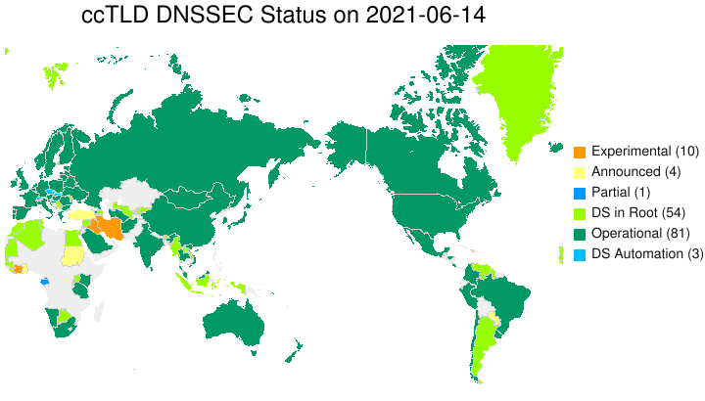
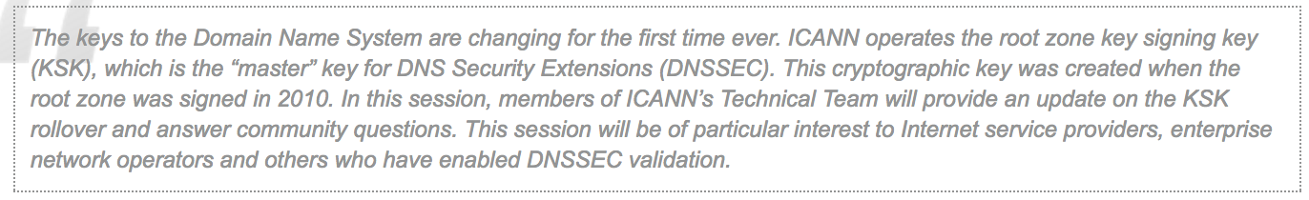
DNS Sec Deployment
Notes:
https://en.wikipedia.org/wiki/List_of_Internet_top-level_domains https://en.wikipedia.org/wiki/Domain_Name_System_Security_Extensions#Deployment

Slide 69
DNSSEC is Great!
DNSSEC is great! Right?
• We can now tell if a DNS response is authentic or not
• Any effort to intercept a DNS response and substitute something else
will fail on validation
• So everyone should be using DNSSEC to sign their DNS names – right?
Problem with leaks?

Slide 70
NSEC Record Example in DNSSEC
Demonstrating denial of existence between subdomains

Slide 71
What is an NSEC Record?
• NSEC is used in DNSSEC.
• It provides authenticated denial of existence.
• It lists the next valid domain name in canonical order.
• It proves that no names exist between two domain names.

Slide 72
Example Zone: example.com
Existing subdomains:
• a.example.com
• m.example.com
• z.example.com
Canonical order:
a → m → z

Slide 73
Sample NSEC Record
a.example.com. IN NSEC m.example.com. A RRSIG NSEC
Meaning:
• The next valid name after a.example.com is m.example.com.
• No subdomains exist between them.

Slide 74
What Does This Prove?
If a query is made for:
• b.example.com
• k.example.com
The NSEC record proves these names do not exist
because they fall between a and m.

Slide 75
Other Problems with DNSSEC
Beyond zone enumeration

Slide 76
1. Key Management Is Difficult
DNSSEC uses cryptographic keys.
Keys must be created, stored, protected, and rotated.
If a key is lost or misconfigured, the domain may stop resolving.
Key rollovers are complex and can cause outages.

Slide 77
2. Configuration Mistakes Cause Outages
The DS record at the registrar must match the DNSKEY in the zone.
If they do not match, resolvers will reject the domain.
A small mistake can make the entire website unreachable.

Slide 78
3. Larger DNS Responses
• DNSSEC adds DNSKEY and RRSIG records.
• Responses become much larger.
• Large UDP packets may be fragmented.
• Some networks drop fragmented packets.

Slide 79
4. Reflection and Amplification Risk
• DNS uses UDP, which can be spoofed.
• DNSSEC responses are larger than normal DNS responses.
• Attackers can abuse this to amplify DDoS attacks.

Slide 80
5. Performance Overhead
• Servers must generate digital signatures.
• Resolvers must verify signatures.
• This adds CPU and memory overhead.

Slide 81
6. Limited Security Scope
• DNSSEC protects integrity of DNS data.
• It does not encrypt DNS traffic.
• It does not protect against all types of attacks.

Slide 82
Further reading
https://www.internetsociety.org/deploy360/dnssec/maps/
https://www.potaroo.net/ispcol/2024-05/dnssec-fin.html
https://www.apnic.net/community/security/dnssec/

